Slide 1

Health Perceptions Across Age and Gender: A Comprehensive Analysis of Canadian Health Indicators
Notes:
"Welcome everyone! Today, we’ll be presenting our capstone project: Health Perceptions Across Age and Gender. My name is Surya and my teammates are syed, tabit, manju, kushi and Preeti. We are the Straw Hat Pirates

Slide 2

How can data-driven analysis reveal meaningful patterns of health indicators across demographics and regions?
Let’s uncover the stories hidden in the numbers
Notes:
"Did you know that understanding health trends isn't just about looking at the data — it's about uncovering hidden patterns that can shape public health strategies?
Imagine if we could predict where health disparities are most prominent across Canada, based on factors like age, gender, and geography. That's exactly what we set out to explore in our project."

Slide 3

DATA OVERVIEW
Data Source:
The dataset is from Canada's national statistical agency
Data Type:
Mixed: Categorical (e.g., Gender, Age Group, Geography) and Numerical (e.g., Indicator values).
Key Variables:
Geography: Regions analyzed (e.g., Canada or specific provinces).
Age Group: Age categories such as "12 to 17 years" or broader ranges.
Gender: Male, Female, and combined totals.
Indicators: Health metrics like "Perceived health" or confidence intervals.
Value: Numeric representation of the indicator.
Notes:
"The dataset we analyzed comes from Canada’s national statistical agency and includes a mix of categorical data like gender, age group, and geography, alongside numerical indicators such as perceived health scores. Key variables include:
Geography: Regions analyzed.
Age Group: Categories like '12 to 17 years.'
Indicators: Health metrics such as 'perceived health' or confidence intervals. This variety allows us to analyze health trends comprehensively across demographics."

Slide 4
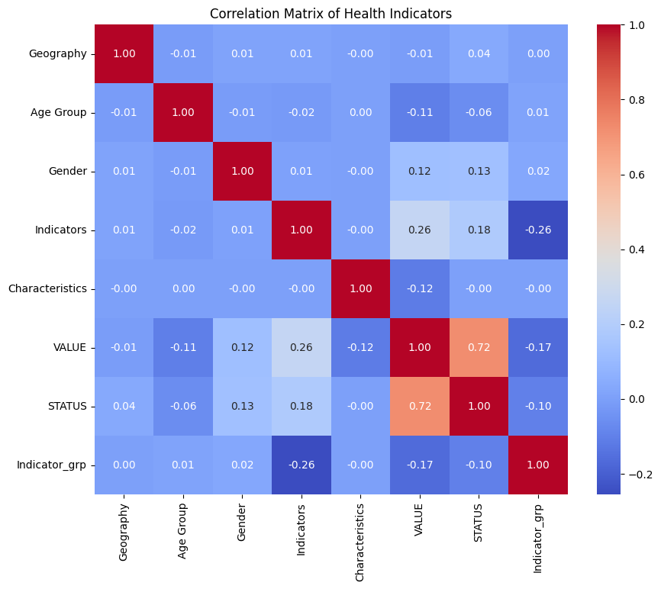
Heat map to find correlation
Notes:
"Here, we’ve visualized the relationships between variables using a heat map. This type of visualization is useful for understanding the correlation between multiple features at once. For example, we were able to quickly identify how perceived health correlates with age and gender. This helped us identify potential areas for further exploration, such as regions with significant gender-based health disparities."

Slide 5
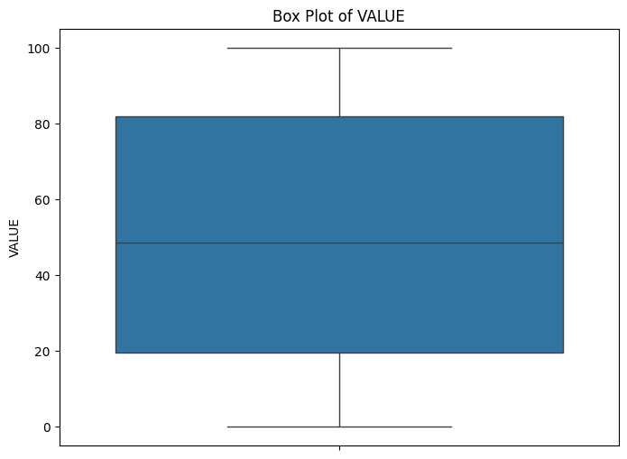
Box plot to find skewness
Notes:
"Next, we used a box plot to better understand the distribution of the data. Box plots are excellent for visualizing the range, median, and outliers within a dataset. They helped us identify skewness in health indicators, which pointed us to important trends like regions with extremely high or low self-reported health scores."

Slide 6
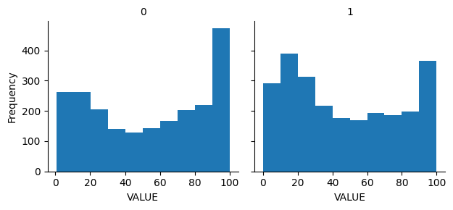
Exploratory data analysis (EDA)
Comparison of health indicator based on Gender (0-male, 1-female)
Notes:
"In this slide, we present a gender-based comparison of health perceptions, where '0' represents males and '1' represents females. We observed distinct trends across genders in terms of perceived health. For instance, females reported higher dissatisfaction with their health in certain age groups. This finding was key in understanding how gender impacts health perceptions, which can inform targeted public health interventions."

Slide 7
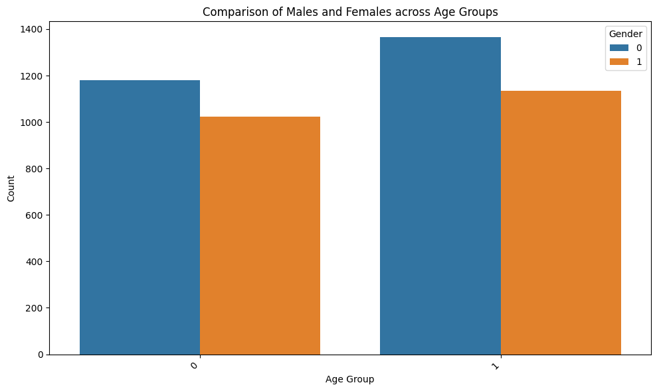
Gender in specific to age groups
(0 is 12-15yrs, 1 is 15-17yrs)
Notes:
"We wanted to dive even deeper, so we broke down health perceptions by age groups and gender. This slide shows how health perceptions differ between males and females in specific age brackets, such as 12–15 years and 15–17 years. This granular analysis helped us understand if there were critical age ranges where health perceptions shift dramatically, particularly between the genders."

Slide 8
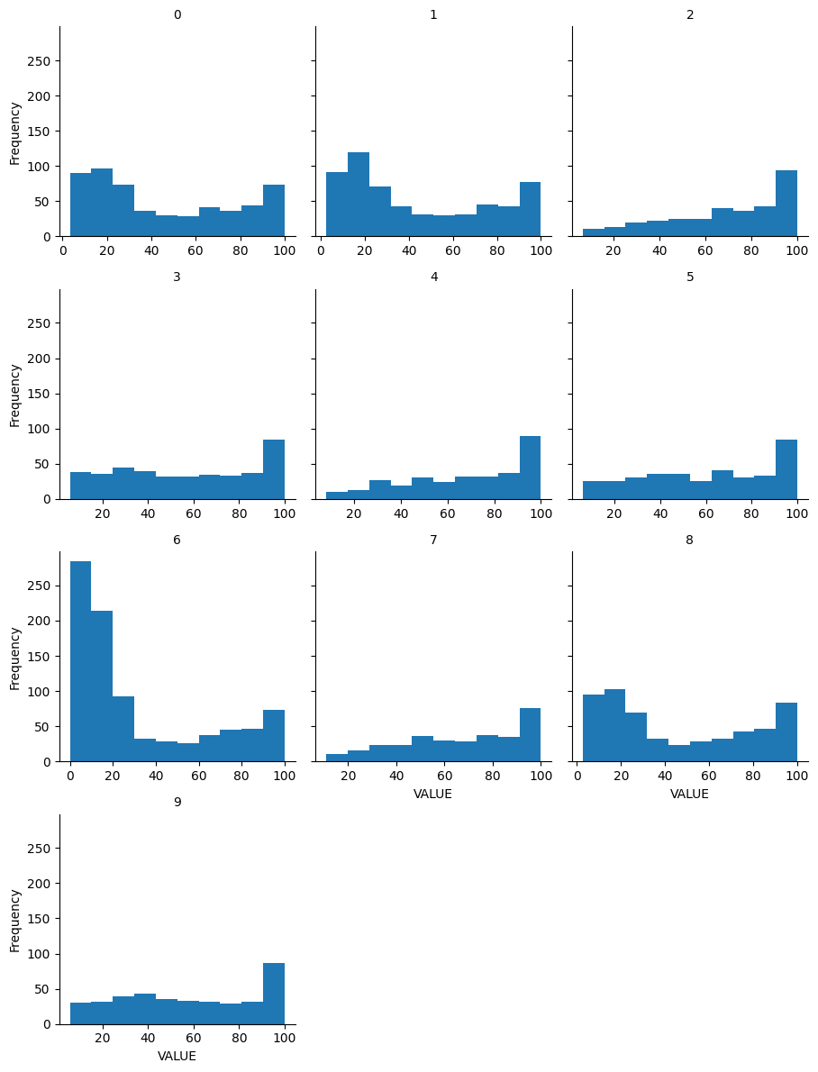
Health indicators in aspect to different Provinces
Notes:
"Here, we broke down health indicators by province, revealing significant geographic disparities. Some provinces showed higher perceived health ratings, while others reported lower satisfaction. By identifying these trends, we can suggest where more focus is needed in terms of public health resources, targeted campaigns, or research."

Slide 9
Evaluation Metrics
Model Evaluation Metrics: Random Forest Regressor
Mean Squared Error (MSE): 168.5432
R-squared (R²): 0.8439
The performance metrics suggest that the Random Forest Regressor is well-suited for the task, although there may still be opportunities to refine the model for greater accuracy (e.g., through hyperparameter tuning, additional feature engineering.)
Model Evaluation Metrics: Gradient boosting Regressor
Mean Squared Error (MSE): 155.4664
R-squared (R²): 0.8569
The metrics shows that the Gradient Boosting model is able to fit the data well and is better at explaining the relationship between the features and the target compared to many other models.
Notes:
"In our analysis, we chose Random Forest Regressor and Gradient Boosting Regressor because they are both powerful ensemble learning methods that handle complex, non-linear relationships well, which is key when working with diverse and potentially messy real-world data like health indicators.

Slide 10
Model Comparison
Model Performance:
The Gradient Boosting model outperforms the Random Forest model in terms of both R² (explained variance) and MSE (prediction error), making it the better model in this context.
With an R² of 85.61%, Gradient Boosting explains a larger proportion of the variance compared to Random Forest, making it a better predictor overall.
The MSE of 155.47 is lower, indicating that Gradient Boosting's predictions are closer to the actual values, leading to fewer large errors.
Notes:
Random Forest Regressor: Achieved an MSE of 168.54 and R² of 84.39%.
Gradient Boosting Regressor: Performed better, with an MSE of 155.47 and R² of 85.69%. "When comparing the two models
Gradient Boosting outperformed Random Forest in terms of both accuracy and model fit. Gradient Boosting achieved a lower MSE and higher R², meaning it was able to explain more of the variance in the data and predict health outcomes with greater precision. This was important because we needed a model that could provide the most reliable predictions for public health planning."

Slide 11

Implication
Practical Applications: Public Health Policies: Health perception across age, gender, and regions informs targeted health interventions. Resource Allocation: Knowledge of regions or demographics with lower health satisfaction prioritizes resource allocation. Health Campaigns: Targeted programs to increase health awareness in vulnerable groups.
Potential Impact: Demographic-specific health trends are better understood, thus enabling more effective public health strategies. Data-driven decision-making enhances efficiency in addressing health disparities. It encourages further analysis, such as predictive modeling, to anticipate future trends. These implications highlight the dataset's potential to shape actionable health solutions and long-term impact.
Notes:
"The findings from our project have several important implications:
They can guide public health policy by identifying vulnerable populations based on age, gender, or region.
They can help allocate resources more effectively, ensuring regions with lower health satisfaction receive the attention they need.
The results can drive health campaigns aimed at improving specific health perceptions among targeted groups. This data-driven approach allows us to proactively address health issues before they become critical, ensuring a more efficient and effective public health system."

Slide 12

Recommendations
ACTIONABLE INSIGHTS:
Target Vulnerable Groups: Demographics with poor health satisfaction include specific age groups or genders, and improving health awareness and resources should be concentrated in those groups.
Regional Health Programs: Resources should be spent on regions that show huge gaps in health indicators.
LIMITATIONS:
Data Gaps: Missing values and low data granularity may reduce the depth of analysis.
Scope: The scope of the analysis is descriptive, without predictive or causal modeling. Thus, the forward-looking insights are limited.
FUTURE WORK:
Incorporate Additional Data: Include socio-economic factors and lifestyle variables for a comprehensive view.
Predictive Modeling: Apply machine learning to forecast health trends, simulating potential interventions.
Longitudinal Analysis: Examine data over time to capture evolving health patterns.
“These recommendations focus on enhancements to the current insights, fill in gaps, and provide a basis for future development”
Notes:
"Based on our findings, we recommend the following:
Targeting Specific Demographics: Focus on groups with lower perceived health, especially females in certain age ranges.
Regional Programs: Implement province-specific programs to address regional health disparities. We also acknowledge the limitations of our analysis, including missing data and the lack of causal analysis. Future studies could incorporate socioeconomic data and use more advanced modeling techniques to deepen our insights."

Slide 13
Conclusion
Overview
The health perception in age, gender, and regions gives several important insights from the descriptive analysis and visualizations of the project. Cleaning and preparing the data greatly improves the quality and usability of the dataset to bring about meaningful trends.
Key Takeaways
Younger age groups have higher health perceptions compared to older demographics. Minor but consistent gender differences in health satisfaction. Regional disparities emphasize the importance of health interventions at regional levels.
Final Thought
This analysis thus forms the basis for deeper analyses in health data and points out the importance of evidence-based approaches in the formulation of public health policies. Further work could use predictive modeling to better anticipate trends and optimize interventions.
Notes:
"In conclusion, our project successfully analyzed Canadian health data, uncovering key trends related to age, gender, and geography. These insights can guide targeted public health strategies, resource allocation, and future research. This analysis not only helps us understand the current health landscape but also provides a foundation for developing more effective interventions."

